Slide 1
Microscopy imaging

Slide 2
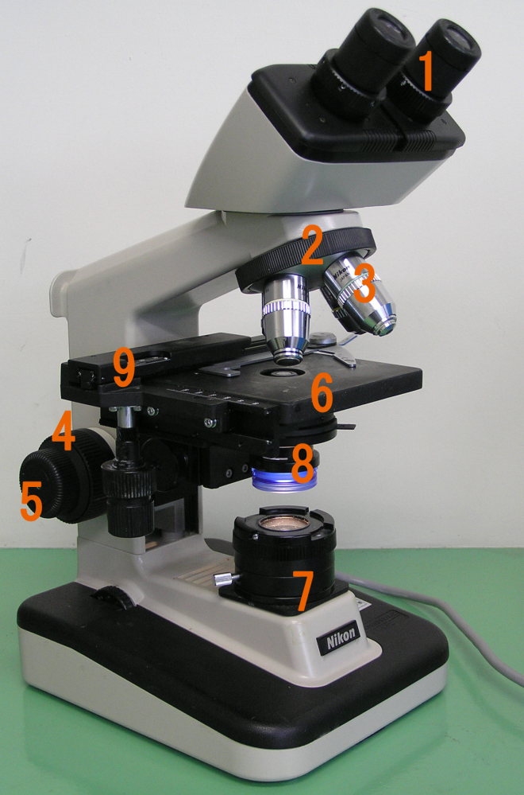
Standard microscope
1. Eyepiece (ocular lens)
2. Objective turret to hold multiple objective lenses
3. Objective lenses
4. Focus knobs (to move the stage), coarse
5. Focus knobs, fine adjustment
6. Stage (to hold the specimen)
7. Light source (a light or a mirror)
8. Diaphragm and condenser
9. Mechanical stage

Slide 3
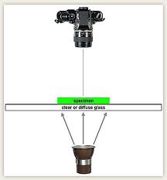
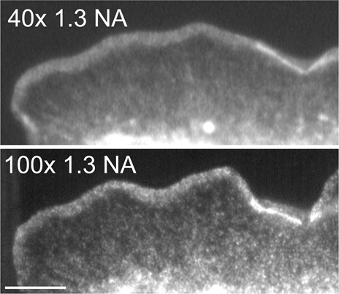
Transillumination
NA = n sin(ϕ)

Slide 4
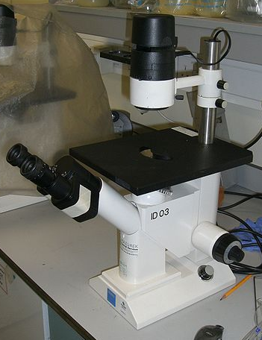
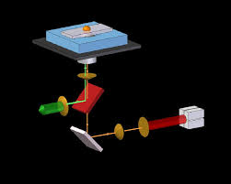
Inverted microscope

Slide 5
Imaging with fluorescence
The sample contains one or more fluorescent substances – fluorophores
Each fluorophore emits light at a specific waveband when stimulated (excited) by light at a different, lower, wavelength

Slide 6
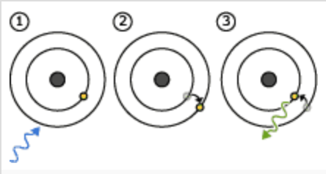
Principle of Fluorescence
Energy is absorbed by the atom which becomes excited.
The electron jumps to a higher energy level.
Soon, the electron drops back to the ground state, emitting a photon (or a packet of light) - the atom is fluorescing.
http://www.nobelprize.org/educational/physics/microscopes/fluorescence/

Slide 7
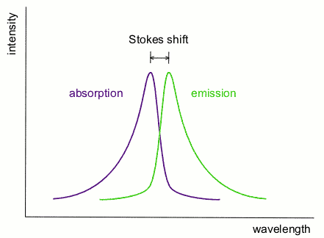
Principle of Fluorescence
Both absorption and emission wavebands are unique for a particular molecular structure of a fluorophore.
The difference between the absorption and the emission peak is called Stokes shift.
Fluorescence efficiency (quantum yield) is the ratio of the number of photons emitted to the number of photons absorbed

Slide 8
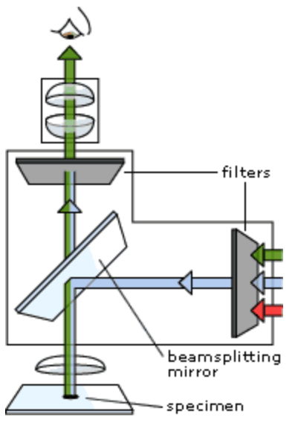
Fluorescence microscope

Slide 9
Fluorescence microscope
Light source is filtered to let through only the excitation waveband
Excitation light illuminates the specimen
Emission light (much weaker than excitation light) is re-emitted from the specimen
The second filter lets through only the emission waveband
This light is then recorded by the microscope’s camera

Slide 10
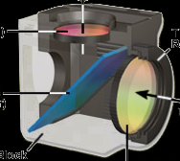
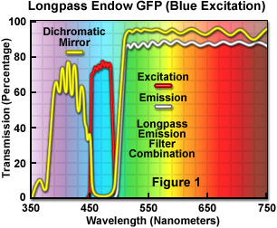
Dichroic (beamsplitter) mirror
Emission filter
Dichroic mirror
Excitation filter

Slide 11
Applications of fluorescence microscopy
Fluorescence microscopy has revolutionised biomedical sciences (Nobel Prize!)
Hundreds of fluorescent compounds have been created by chemists, including synthetic nano-beads
Used as markers that can be attached to various very specific cellular and sub-cellular structures, proteins and compounds of interest
Used to study biological systems is vitro and in vivo

Slide 12
Fluorescence Microscopy
Osamu Shimomura, Martin Chalfie and Roger Tsien,
Nobel Prize for Chemistry, 2008
Osamu Shimomura, Professor Emeritus at Marine Biological Laboratory (MBL) in Woods Hole, Massachusetts was awarded the Nobel Prize in Chemistry in 2008 for the discovery and development of green fluorescent protein (GFP) with two American scientists: Martin Chalfie of Columbia University and Roger Tsien of the University of California-San Diego. They were jointly awarded for discovering the green fluorescent protein (GFP) and further development for use in cell biology. By fluorescence of GFP, the spatial and temporal distribution of other proteins in living cells, tissues or organisms can be observed directly, thus laying the foundation for modern fluorescence microscopy.

Slide 13
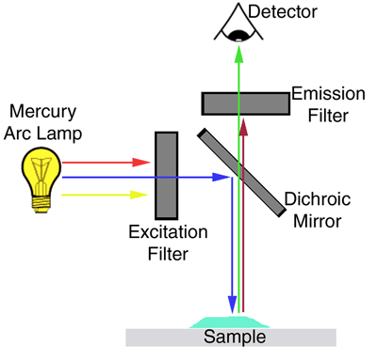
Epifluorescence microscopy
The entire sample is illuminated

Slide 14
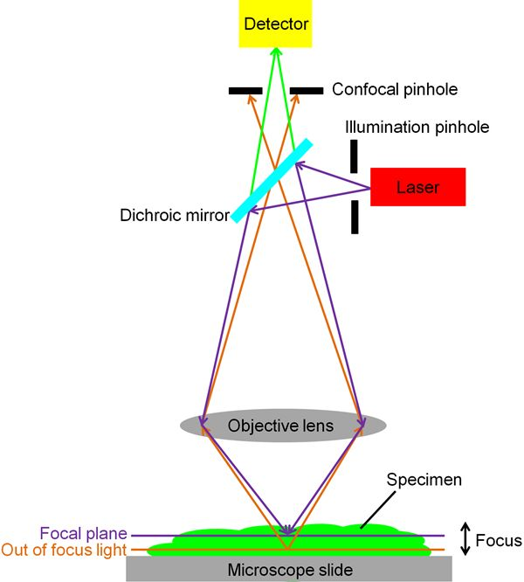
Confocal microscopy
Only a thin layer of the sample is illuminated

Slide 15
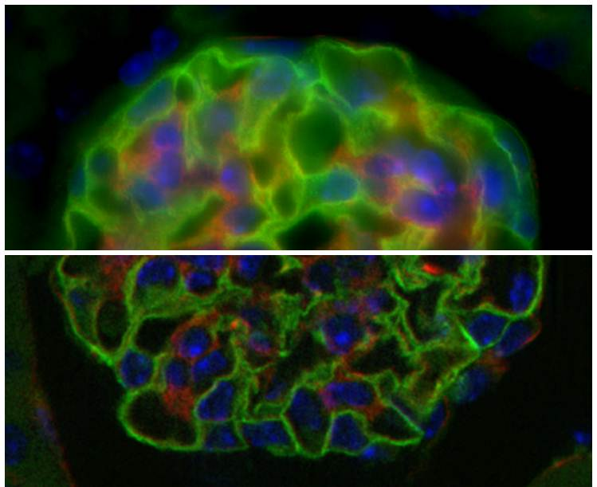
Epiluminescence vs confocal microscopy

Slide 16
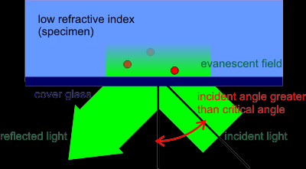
TIRF microscopy
TIRF = Total Internal Reflection Fluorescence
100 nm

Slide 17
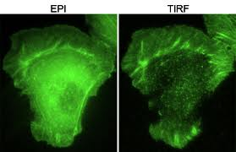
Epiluminescent vs TIRF Microscopy

Slide 18
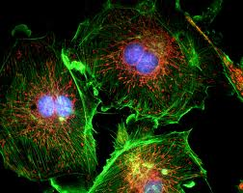
Multifluorescence microscopy
Imaging several compounds simultaneously

Slide 19
Challenges in multifluorescence microscopy
Different fluorophores require different filter sets
Fluorophores are bleached by light
Live cells exhibit motion
Cell bodies emit very broad-band background fluorescence

Slide 20
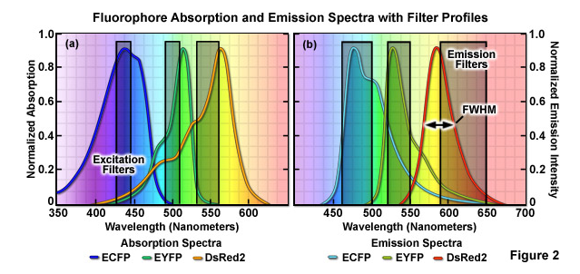
Challenges in multifluorescence microscopy

Slide 21
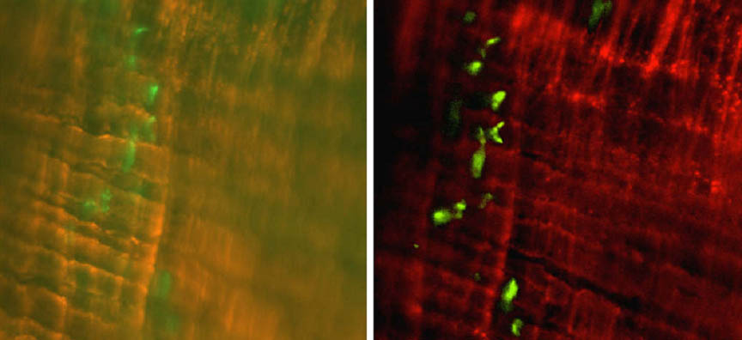
Challenges in multifluorescence microscopy
We can unmix emissions after image acquisition

Slide 22
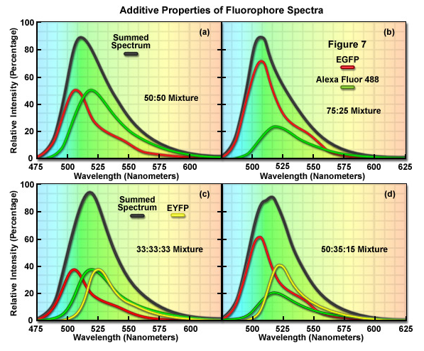
Spectral unmixing

Slide 23
Spectral unmixing
A method for isolating contributions of the individual fluorophores from their mixture
Normally requires the knowledge of the emission spectra of the fluorophores
Assumption: the combined emission is a linear combination of the contributing emissions
Normally requires imaging at a number of spectral wavelengths

Slide 24
Spectral unmixing
K – the number of wavelengths at which the image was acquired
N – the number of fluorophores
L_{n} – the emission spectrum of fluorophore n; the length of each spectrum L_{n} is K
M - the number of samples (pixels in the image). A multispectral image I comprises K×M spectral measurements in total.

Slide 25
Spectral unmixing
A spectrum s at any given pixel has contributions from N library spectra with a coefficient a_{n} describing the relative abundance of L_{n}:
s = L a
s – a column vector of K spectral measurements
L - K×N matrix of N K-dimensional library spectra L_{n}
a - N-dimensional column vector of abundance coefficients
If K≥N,
a = L⁻¹ s

Slide 26
Spectral unmixing examples
Fluorescent beads – testing the method
In mixture
Unmixed

Slide 27
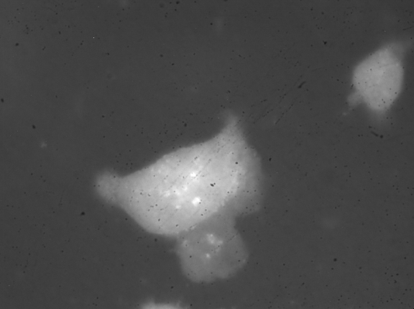
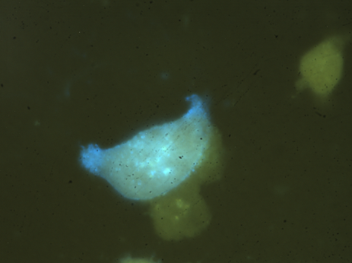
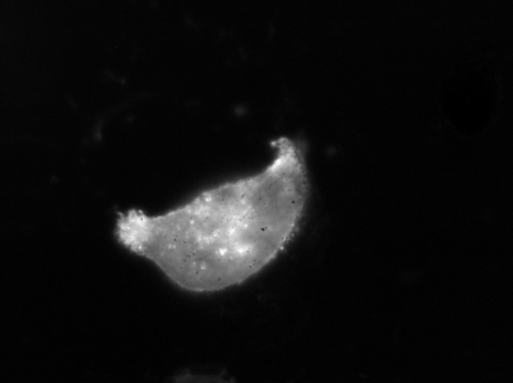
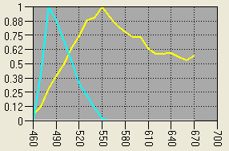
Cell Fluorescence Studies
Linear
Unmixing
Cell Autofluorescence
Multispectral image
CFP Fluorescence
Reference spectra

Slide 28
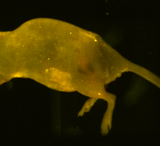
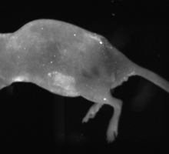
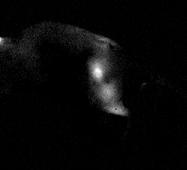
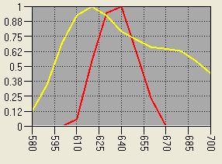
Cancer research
Linear
Unmixing
Autofluorescence
Multispectral Image
Quantum Dot Fluorescence
Reference Spectra

Slide 29
Other microscopies
FRET (Förster Resonance Energy Transfer)
DIC (Differential Interference Contrast)
Phase Contrast Microscopy
Super-resolution techniques
PALM (Photoactivated Localization Microscopy(PALM))
STORM (Stochastic Optical Reconstruction Microscopy
STED (Stimulated Emission Depletion)
Electron microscopies

Slide 30
FRET microscopy
FRET = Förster Resonance Energy Transfer
Detector
Emission filter
R1
R2
Dichroic mirror
DM
Excitation filter
Ex
White light source
Specimen

Slide 31
FRET microscopy
Excitation light stimulates one of the fluorophores
If the second fluorophore has its excitation waveband overlapping with the emission waveband of the first fluorophore, and it is at the same location, it resonates and becomes excited
It emits radiation at its characteristic emission waveband

Slide 32
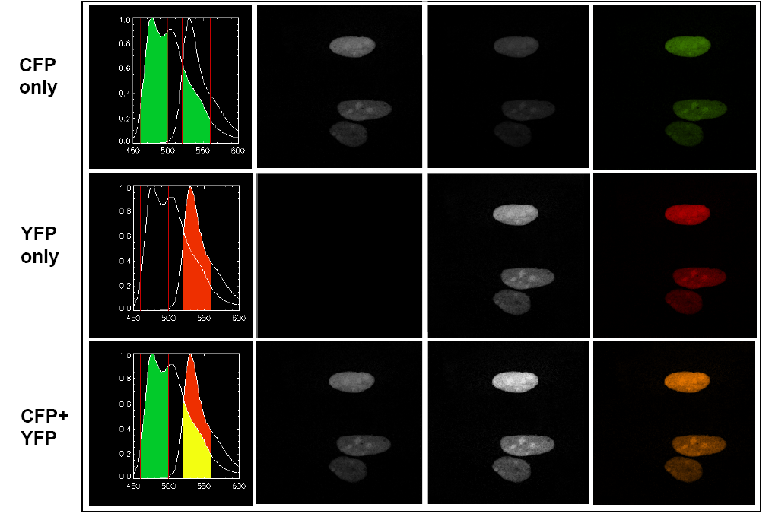
FRET microscopy
http://www.embl.de/eamnet/downloads/modules/FRET_teaching_module.pdf

Slide 33
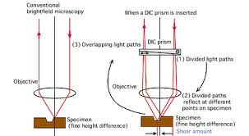
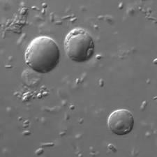
DIC Microscopy
DIC = Differential Interference Contrast

Slide 34
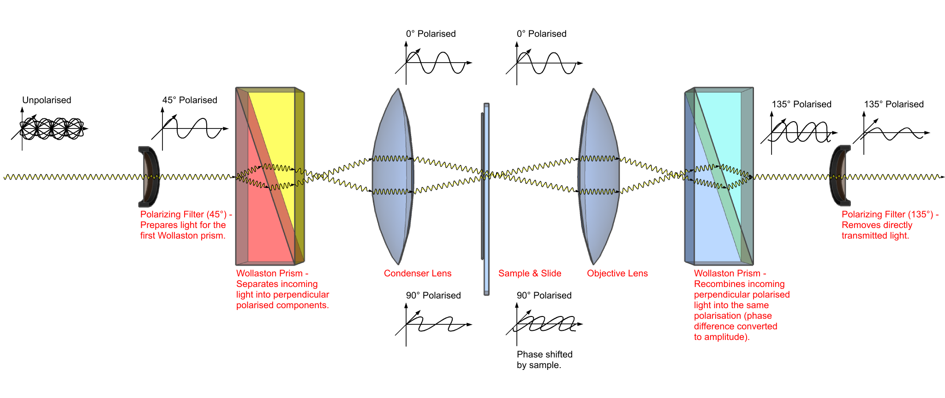
DIC Microscopy

Slide 35
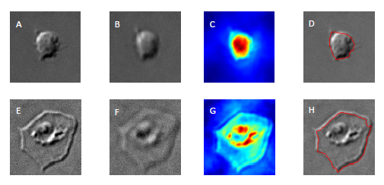
DIC Microscopy
Computing estimates of platelet cell size and thickness

